Slide 1





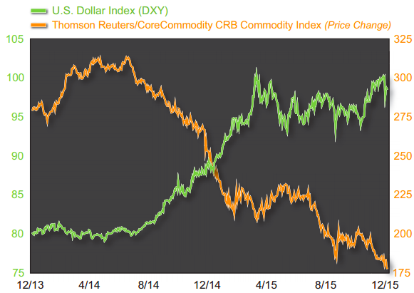
Predicting Commodities Prices:
A Data-Mining Approach
Meiqing Zhang
Erin M. Ochoa
Rodrigo Valdes

Slide 2






Objective: predict prices of commodities
Factors:
Geophysical
Economic
MOTIVATION

Slide 3


Data preparation
Geographic indicators
Precipitation
Temperature
Data preparation
Economic indicators
Inflation
Stock markets
Exchange rate
Industrial production
Recession cycle
Power usage

Slide 4




Commodities prices
Geographic indicators
Economic indicator: recessions
Economic indicators
Power usage
Data preparation
Data sources

Slide 5
Data Catalogs
41 Economic Indicators and 10 Commodities Prices
GEM
(Global Economic Monitor)
Countries: World and 7 major economies
Indicators: 5 economic indicators
GEM Commodities
Countries: World
Indicators: 10 commodities (dependent variables) and crude oil prices (independent variable)
Data preparation
Data collection
Source: The World Bank API

Slide 6

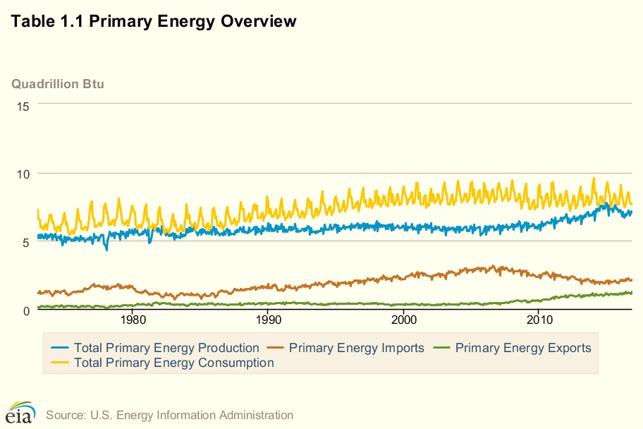
NASA Precipitation & Temperature:
Global
Northern Hemisphere
Southern Hemisphere
Tropics (precipitation only)
EIA :
11 Electricity usage variables
NBER:
Months Elapsed Since Current Recession Began
Months Elapsed Since Last Recession Ending
Data preparation
Data collection
Sources: NASA, EIA, NBER
Notes:
EIA: Energy Information Administration
NBER: National Bureau of Economic Research

Slide 7
Merging tables
Squared and cubic variables
Cleaning time formats
Unified dataframes for analysis
Data preparation
Data munging and cleaning

Slide 8
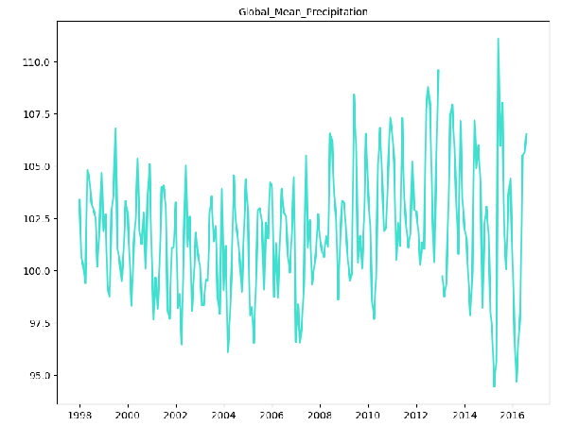
Data analysis
Diagnostic plotting

Slide 9
Loop for best five independent variables
Best number of lags
Run the model with the best lags and variables
Data analysis
Forward selection model

Slide 10
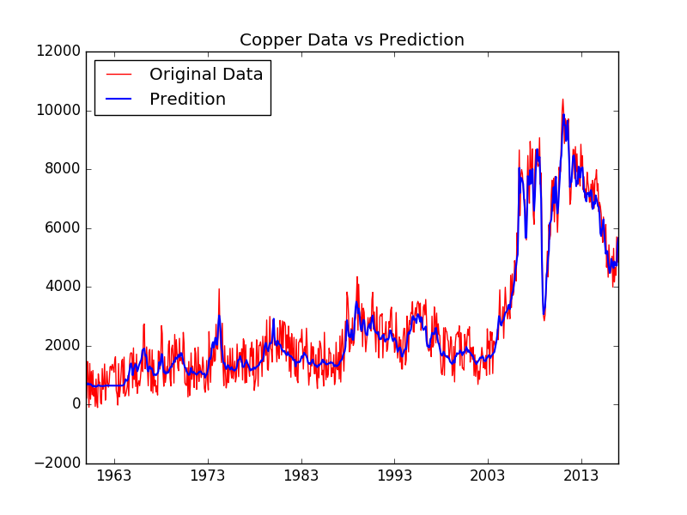

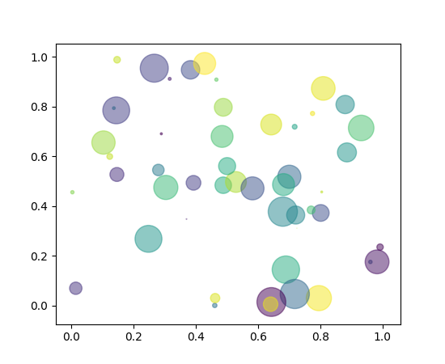
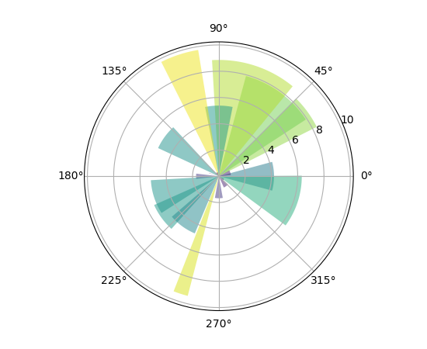
Data analysis
Results and visualization
Plot
Autoregressive terms
Best five variables

Slide 11



Data presentation
Reporting

Slide 12

Next Steps
Analysis and graphing
Report output
Documentation

Slide 13

Thank you

